Slide 1
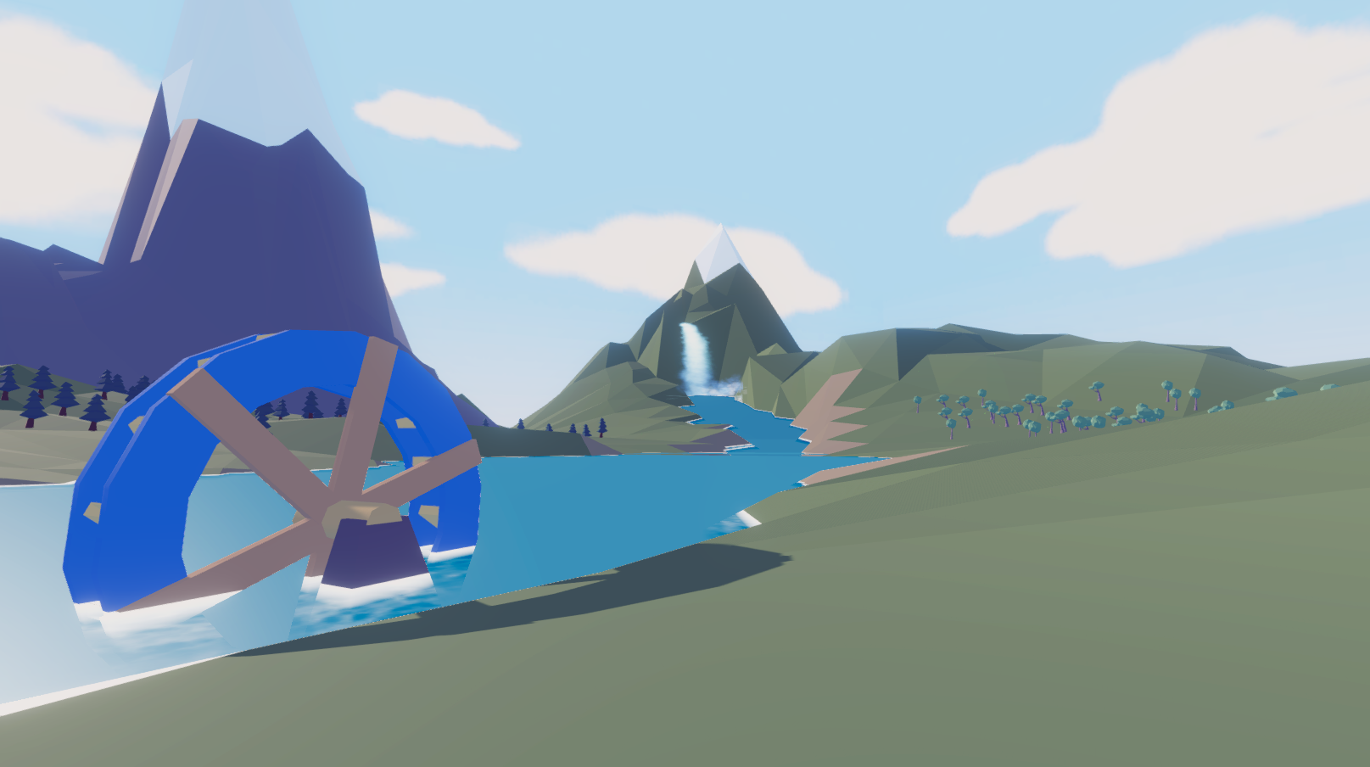


Ma Wai Kin Coding / UI design

Slide 2
The game genre
This is an Action role-playing game.
The grippe game plot, leading with incomparable immersion.
Players can grow by gaining experience points
In terms of combat, in addition to using magic, the character can also use the sword combo system, to have a great combat experience.

Slide 3
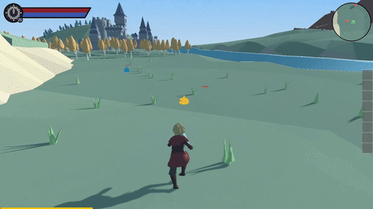
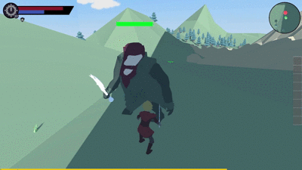
Make the great combat experience
In addition to joining the Combo System and Magic System, I also designed a dodge function to enhance the player’s flexibility
In addition to the flexibility of operation, when the player is hit, the interface will produce a slight vibration-like effect.
This can increase the sense of realism and let the player experiences the feeling of being hit.

Slide 4
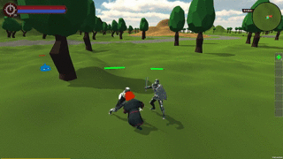
Design a smart AI
The most basic AI modes are “standby”, “detect enemies”, “chase” and “return”. Before the enemy sees the player, they will hover in the standby and detection state.
When the player is found, it will chase until the opponent dies or escapes a certain range.
If the player escapes successfully, they will return. When the enemy fights the player, they enter a very monotonous mode, just chasing the protagonist constantly. Therefore, new elements have been added. When the player enters their field of vision, they will have 3 behaviors. In addition to the original chasing mode, a backward and defense mode has also been added.
Backward mode is to temporarily keep a certain distance from the player character and enter the defense mode after a certain distance.
This can make the enemy appear more vivid, as if observing the protagonist and then looking for a chance to attack again.

Slide 5
Save&Load System
The Game has SaveSystem, it used jsonutility to save&load the data.
The game record are automatically saved when the player closes the game, when the player returns to the game, they can choose to start a new game or continue the last record.
The record file includes many variables, including player level, number of items, main line progress, etc. When the record is read, the variable is returned to the previous state by executing the get function.

Slide 6
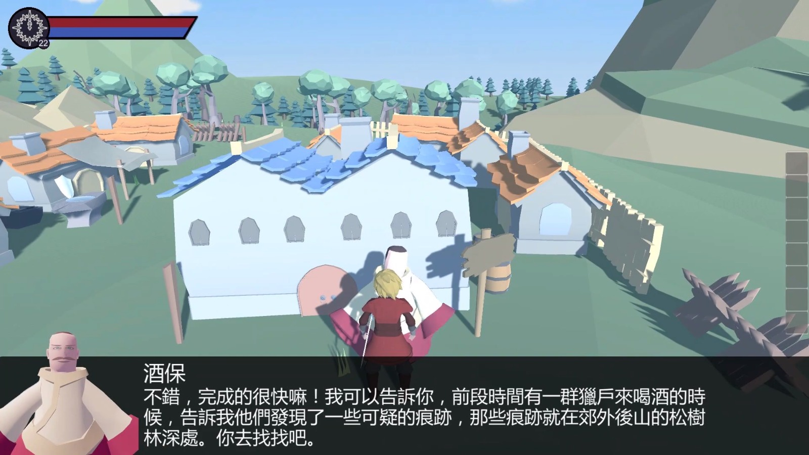
The User Interface
Dialogue system
The Npc is mainly divided into two categories, Quest Npc and Normal Npc.
When talking to Quest Npc, the main storyline will be triggered.
Quest Npc : follow above dialogue depends on quest.
Normal Npc: Canned dialogue.

Slide 7
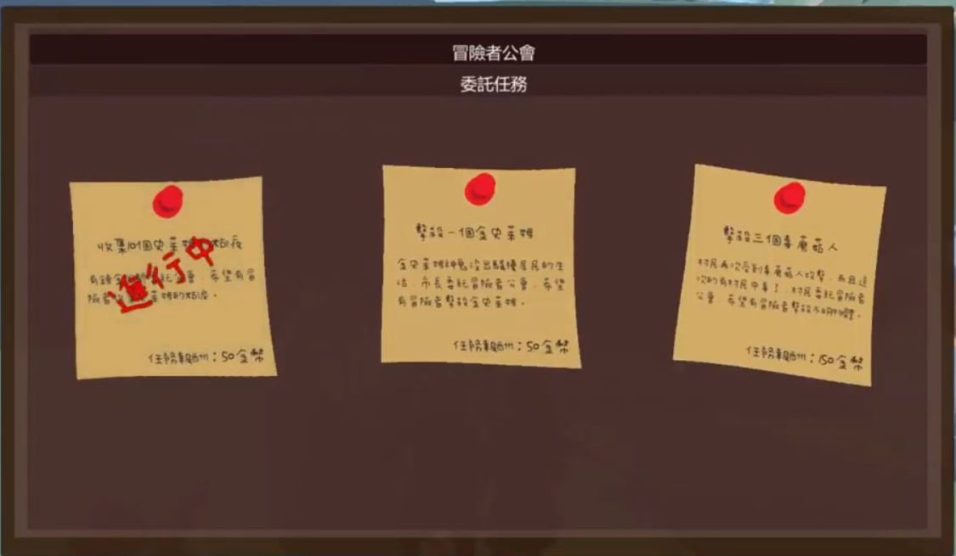
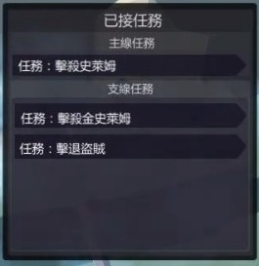
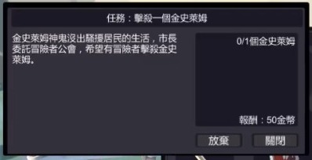
The User Interface
Quest Board
The quest is mainly divided into two categories, Side quest and Main quest.
Can take the Side quest at Quest Board.
Accepted Quest Board
Here can view accepted quests, and check the details.

Slide 8
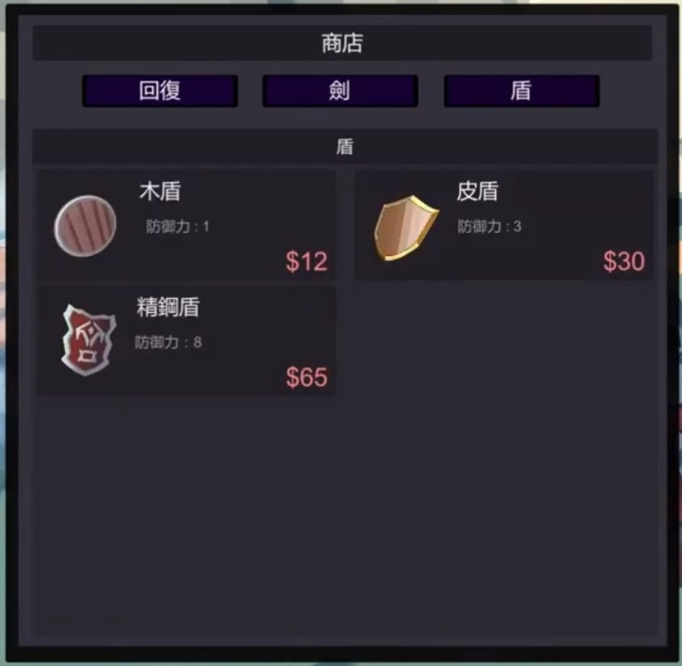
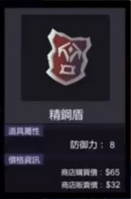
The User Interface
Shop
Players can buy and sell equipment and potions in the shop.
Item details windows
In this window, there are the performance and price of the items.

Slide 9
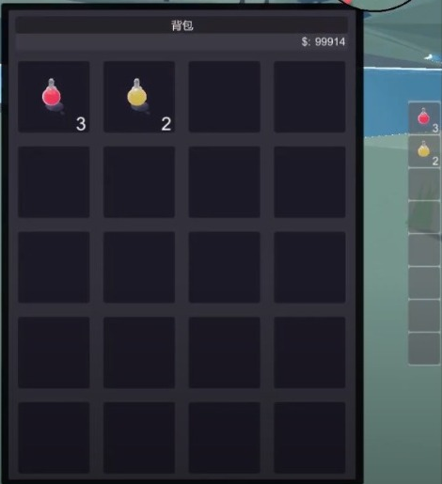
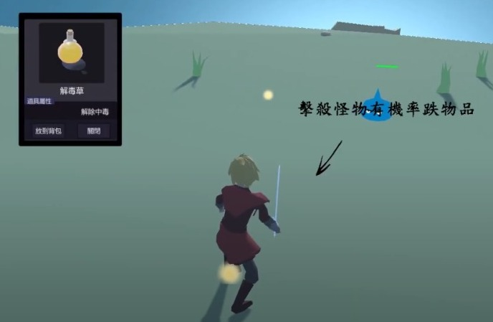
The User Interface
Bag && Quick bar
You can check the number of potions in the bag, and you can add the potion to a Quick bar, which is convenient for players to use. * Quick bar hotkey : 1-8
Item details windows (Enemy drop item)
In this window, there are the performance of the items. Player can choose whether to pick up

Slide 10
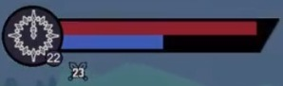
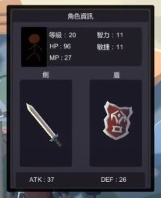
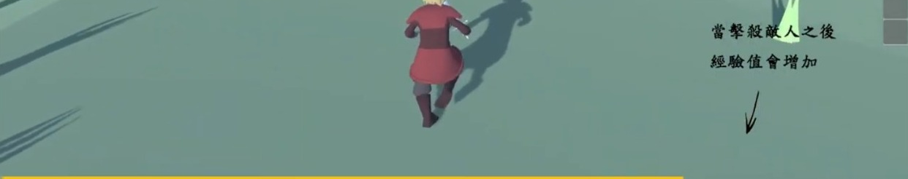
1The User Interface
Player Status windows In here, player can view the player’s detailed status and equipment
A
B
Player Status bar
Red bar : Health bar
Blue bar : Magic bar
A : Player level
B : Player Magic skills cool down time
Experience bar
When the player kill the enemy, that will get the experience. If the experience bar is full, it will be upgraded.

Slide 11
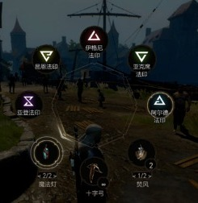
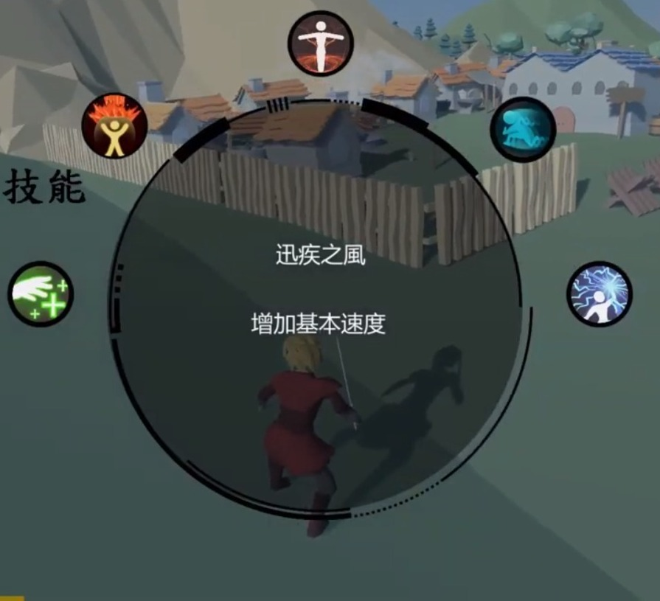
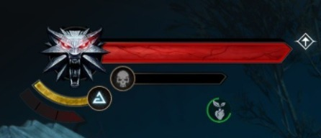
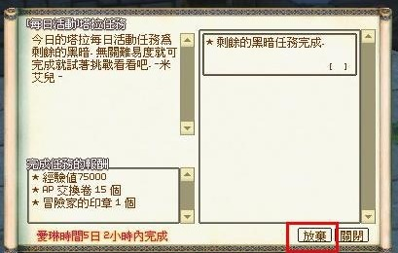
UI design && Reference source
Health bar & magic skill CD time logo
The Witcher 3
- Magic Windows
The Witcher 3
- Quest Board
Mabinogi

